Slide 1
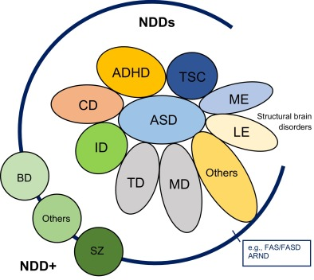
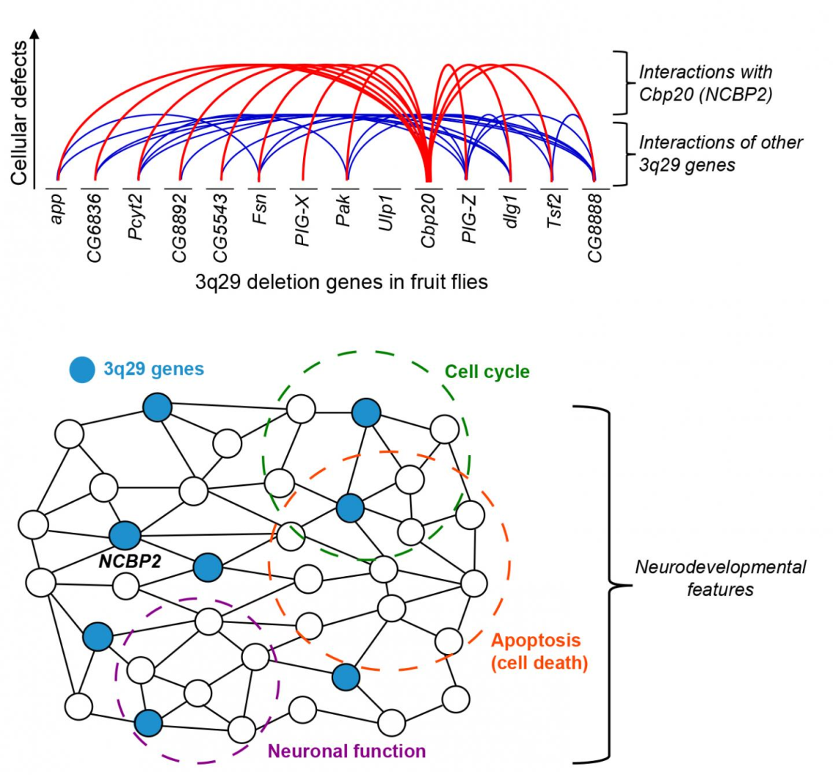
Deep learning model in analysing the Genetic variation associated with the occurrence and progression of Neurodevelopmental disorders

Slide 2
Team Members
COMPUTER SCIENCE | LIFE SCIENCE
Dr. S. Pitchumani Angayarkanni Associate Professor, Department of Computer Science Lady Doak College | Dr. S. Kalaivani Priyadarshini, Assistant Professor, Department of Biotechnology, Lady Doak College
Dr. Sofia, Associate Professor, Department of Computer Science, Lady Doak College. | Ms. Raga Priya UG Student Bioinformatics TN Agricultural university. Coimbatore

Slide 3
Interpretation of the statistical analysis result

Slide 4
Negative correlation of the finding with review of literature & Gene ontology study
 | Gene Name | NDD | Literature with supportive evidence
Pathogenic mutations | X-linked Neuroligin 4 gene (NLGN4X) | Autism | autism spectrum disorders (ASDs) and/or mental retardation (MR) are rare (Daoud , 2009).
Regulation of membrane potential | NLGN3,NLGN4X | Autism | positive regulation of excitatory postsynaptic potential and it is unclear according to the literature of how mutations in NLGN4X result in neurodevelopmental defects is associated with autism (Lingling, 2013)

Slide 5
Negative correlation of the finding with review of literature & Gene ontology study
 | Gene Name | NDD | Literature with supportive evidence
Regulation of membrane potential | SPCOK3 | ADHD | not associated with Negative regulation of cell motility because it is associated with Hemostatic Risk Factors and Arterial Thrombotic Disease(Reiner,2001)
Regulation of membrane potential | MFC2C | (AUTISM,DMD,ADHD | negative regulation of blood vessel endothelial cell migration (Schechter DS et. al., 2017).

Slide 6
Negative correlation of the finding with review of literature & Gene ontology study
 | Gene Name | NDD | Literature with supportive evidence
Cellular response to transforming growth factor beta stimulus | DUSP15 | ADHD | not associated with Negative regulation of cell motility because it is associated with Hemostatic Risk Factors and Arterial Thrombotic Disease(Reiner,2001)
Cellular response to transforming growth factor beta stimulus | HTR3A | (AUTISM | associated with regulation of membrane potential according to gene ontology annotation but it is associated with suicidal behaviour(Souza et. al., 2011).

Slide 7
Negative correlation of the finding with review of literature & Gene ontology study
 | Gene Name | NDD | Literature with supportive evidence
Cellular response to transforming growth factor beta stimulus | LTBP4 | DMD | is associated with transforming growth factor beta receptor signalling pathway and leads to kidney disease (https://maayanlab.cloud/Harmonizome/gene_set/Kidney+Diseases/CTD+Gene-Disease+Associations)

Slide 8
Mismatch in negative correlation findings
 | Gene Name | NDD | Literature with supportive evidence
Vocalization Behaviour | CNTNAP2 | AUTISM | gene as a risk factor for ASD and related neurodevelopmental disorders (Peñagarikano et. al.,2012).
Negative regulation of cell mobility | DAG1 | DMD | gene ontology study online tool mismatches with the findings
cellular response to transforming growth factor beta stimulus | MEF2C | AUTISM

Slide 9
Recommendations:
Electronic health record pertaining to the on medical profiles and diagnostic testing like patient’s profile, vital signs, systems review, clinical impression and diagnosis, medical orders and disposition, if made available in the public repository for NDD it will help in identifying the major cause.
Due to the very complex nature of NDDs, interdisciplinary approaches combining genetics, functional genomics, robust biological models and objective measures of response, such as biomarkers, as well as the capability of researchers and clinicians to work side by side, will be essential.

